Slide 1
The HEAT Pufendorf Project
LUND, SWEDEN 2o may 2015

Slide 2
Aim
To develop a multi- and transdisciplinary research platform to better understand and develop solutions to the LOCAL problems caused by an increased global temperature

Slide 3
HEAT
Problem
Cases
Solutions

Slide 4
Architecture
Water engeneering
WTS
GIS center
Human Ecologi
CEC
Nuklear Physics
Occupational Health
Resilience centre
Public Health
EAT/IKDC
LUCSUS

Slide 5
PROBLEMS

Slide 6
IT WILL BECOME WARMER
WEAK GROUPS WILL SUFFER THE MOST
PERSONS LIVING IN A WARM CLIMATE WILL GET IT WARMER

Slide 7
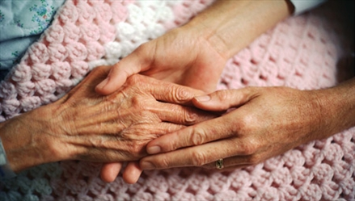

Slide 8
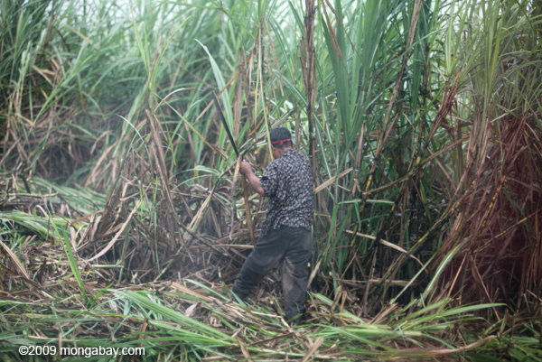

Slide 9
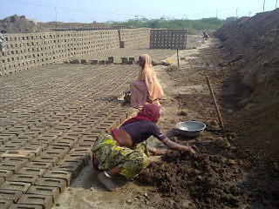

Slide 10
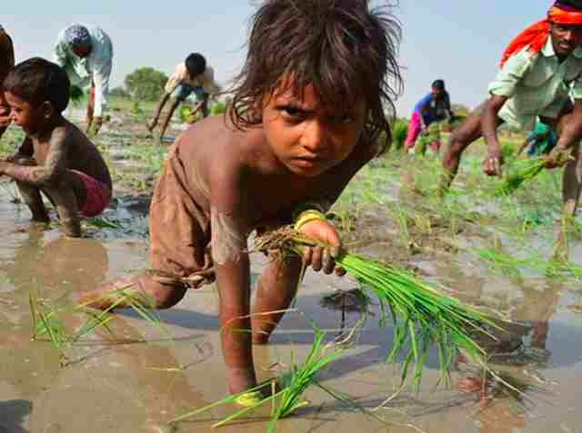

Slide 11
Problems dealt with: Heat and…
Health
Livelihoods
Migration
Work organisation
Urban planning
The role of technology
Intitutional capacity and learning

Slide 12
CASES
Urban planning MALMÖ LUND HJÄRUP
Air conditioning HANNOI
Urban planning and Heat Island ISTANBUL
Livelihood systems EAST AFRICA
Migration HIMALAYA
Suger cane worksers
COSTA RICA
Heat and air pollution KARACCI
Brick workers INDIA

Slide 13
SOLUTIONS

Slide 14
Development
Possible direction
Desired direction
Current state

Slide 15
Solutions dealt with
Better planning
New visions of a future society
Old solutions in new dress- simple technology/ advanced technology
Increase institutional learning decrease institutional barriers
New economic system /large/small scale
Planning principles- think differently

Slide 16
THE REST OF THE AFTERNOON

